Slide 1

C-Group
Your Data Solutions Experts

Slide 2
Who we are? -- Welcome the “C- Group
We are “C-Group,” a data analytical staffing team that can support our clients by supplying enhanced data, analysis, and data visualization to ensure our clients successfully meet their business needs. With the rise of data in today’s economy, data-driven our organization is focused on the practical and technical skills needed to analyze and solve complex data problems.
Vendor Selection Process
Currently, we are pleased to be one of three vendors in contention to become your “vendor of choice,” assisting your organization in meeting your data analytical needs.
Recently, C-Group was able to meet with Jason, the lead analyst for the user interface team, and several of his team members. As part of the vendor selection process, we have been asked to prepare and submit a prototype based on certain weather parameters. Based on our discussion, we were able to outline the initial requirements and create a high-level Business Plan.

Slide 3
What can C-Group do for your Organization?
As per Initial Requirements for our Prototype, C-Group will
Export the data, clean it, and use the weather data to choose the best cities for vacation based on certain weather criteria.
Perform statistical calculations on the data and the weather parameters.
Assist the client in collecting and presenting data for customers via the search page, which they will then filter based on their preferred “weather” travel criteria in order to find their ideal city.
Collect and present data for customers via the search page, which they will then filter based on a customer’s preferred “weather” travel criteria in order to find their ideal city.

Slide 4
Outline for Initial Project Plan:
Task: Collect and analyze weather data across cities worldwide.
Purpose: C-Group will design a prototype Trafalgar Tours will use the data to recommend ideal travel locations based on clients' air quality and weather preferences.
Method: Create a database containing
The world’s ‘Top 100’ cities and their weather data in real time.
This process will entail collecting, analyzing, and visualizing the data.
Analysis of the data will be split into three main parts or stages.
(Optional Nice to Have): Uses of the OpenWeatherMap API to retrieve the JSON weather data from these cities.

Slide 5
Our Approach:
Our Approach:
Collect the Data
Data Source
Weather data from https://openweathermap.org/api/air-pollution
Tracking to investigate Air Quality in Multiple Cities
Table1: For our Pollution Data: air quality standards as per https://openweathermap.org/api/air-pollution
See Screen Shot for Attributes / Column headers explained.
Table2 /Database #2: Top Cities Screen Shot
Data Year Collected in 2022 -
Database Source: Kaggle
Table 3: Air Quality Index /Look-Up Table
Maps, Description of the Air Quality Index
Technical Tool Sets: Python. Tableau, Jupyter Notebook

Slide 6
Project Database
Using AWS RDS to host the database
Postgres Database
pgAdmin to create tables and write queries
There are three tables in the database
Air_Quality_Lookup
Description of air quality based on the air quality index
Air_Pollution_By_City
Data pulled using the Open Weather API
Contains Date, Air Quality Index, City_id
Carbon monoxide (co), Nitrogen dioxide (no2), Ozone (O₃), Sulphur dioxide (so₂), and particulates (PM_{2.5} and PM₁₀)
City
100 cities from Kaggle.
Contains City, Population, Latitude, Longitude

Slide 7
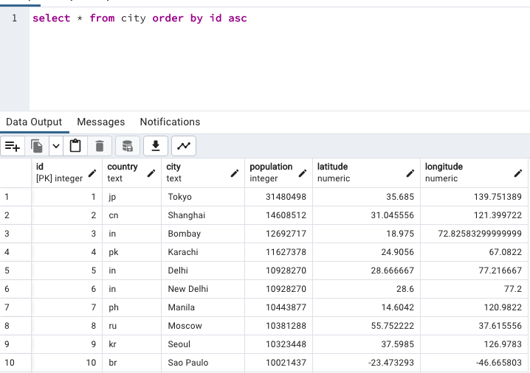
City Table

Slide 8
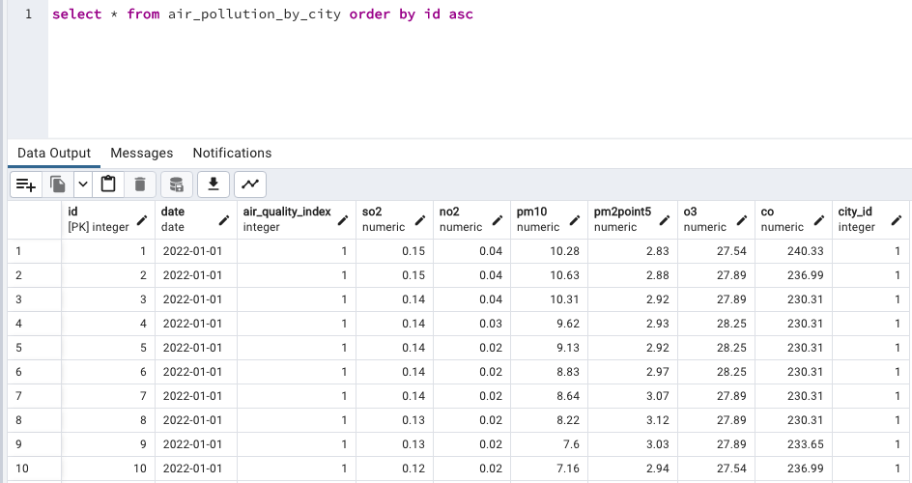
Air Pollution by City Table

Slide 9
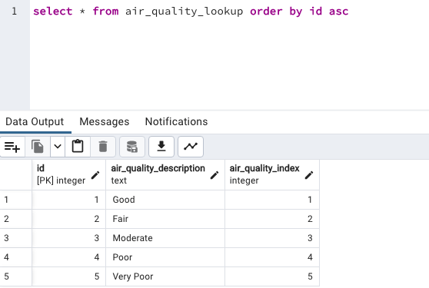
Air Quality Look Up

Slide 10
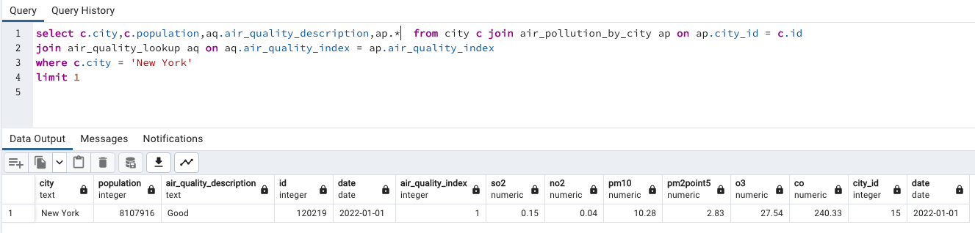
Query Example

Slide 11
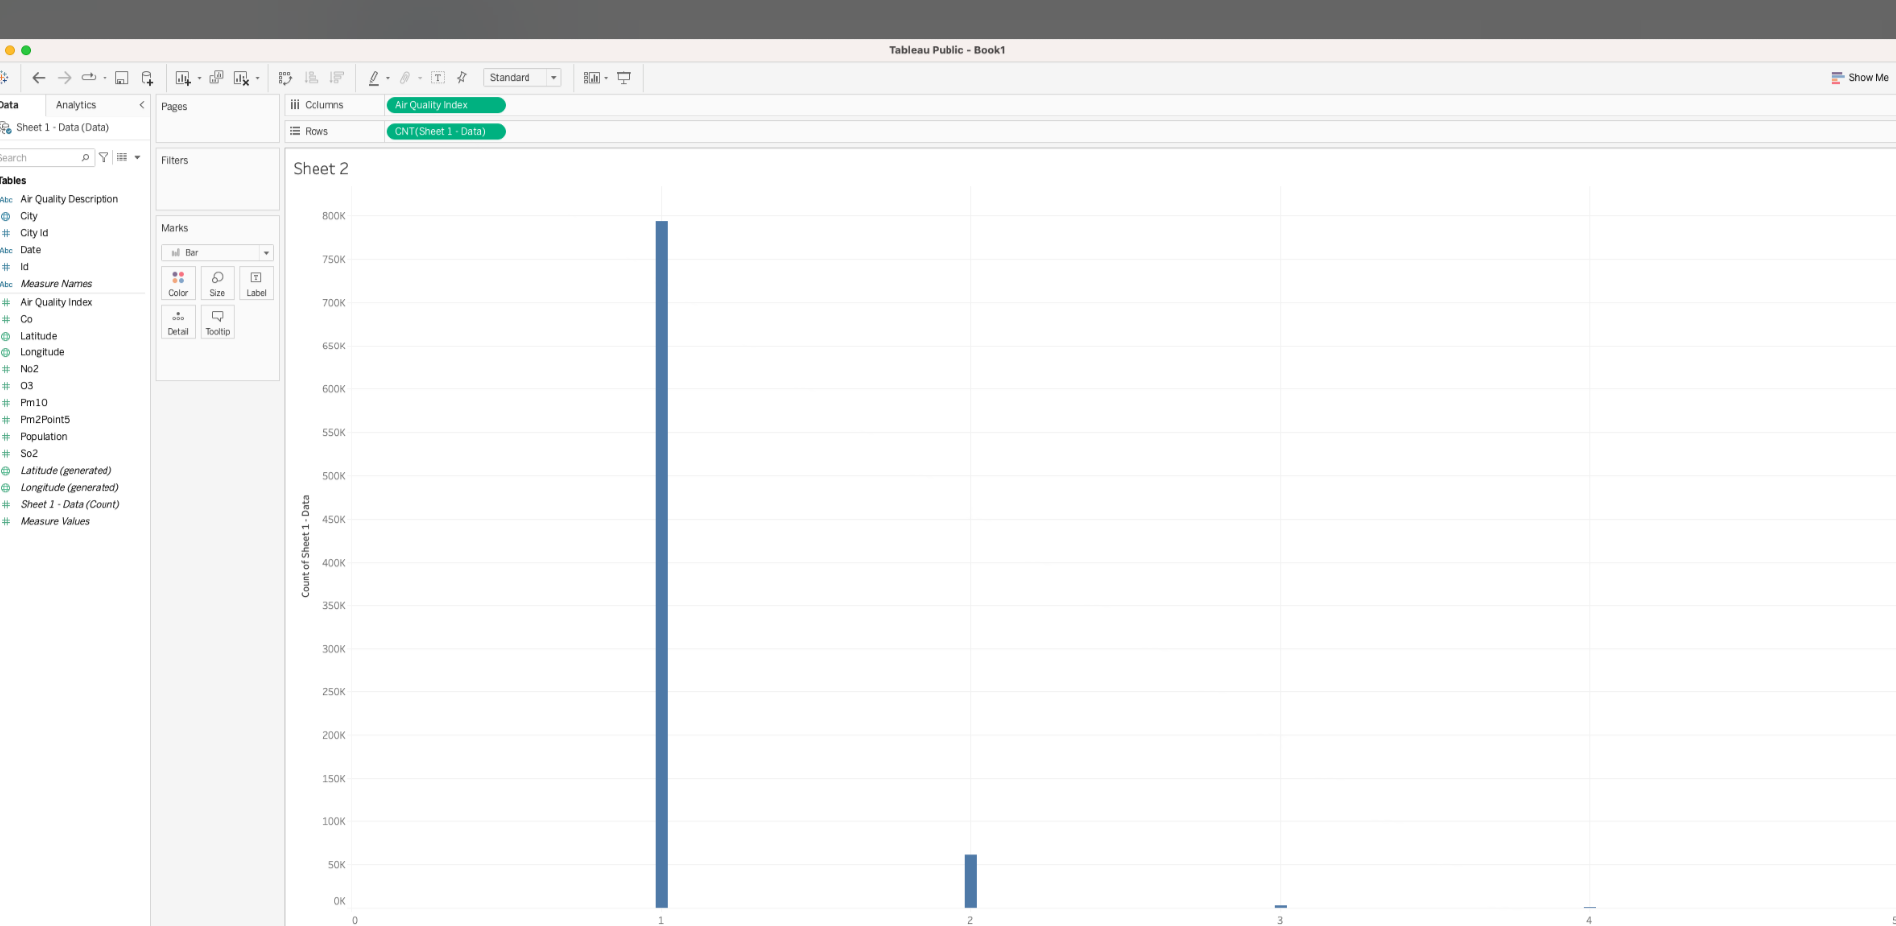
Exploratory Analysis with Visualization
Visualize Travel Data.
Customers can utilize the weather data to choose the best cities for vacation based on certain weather air quality criteria.

Slide 12
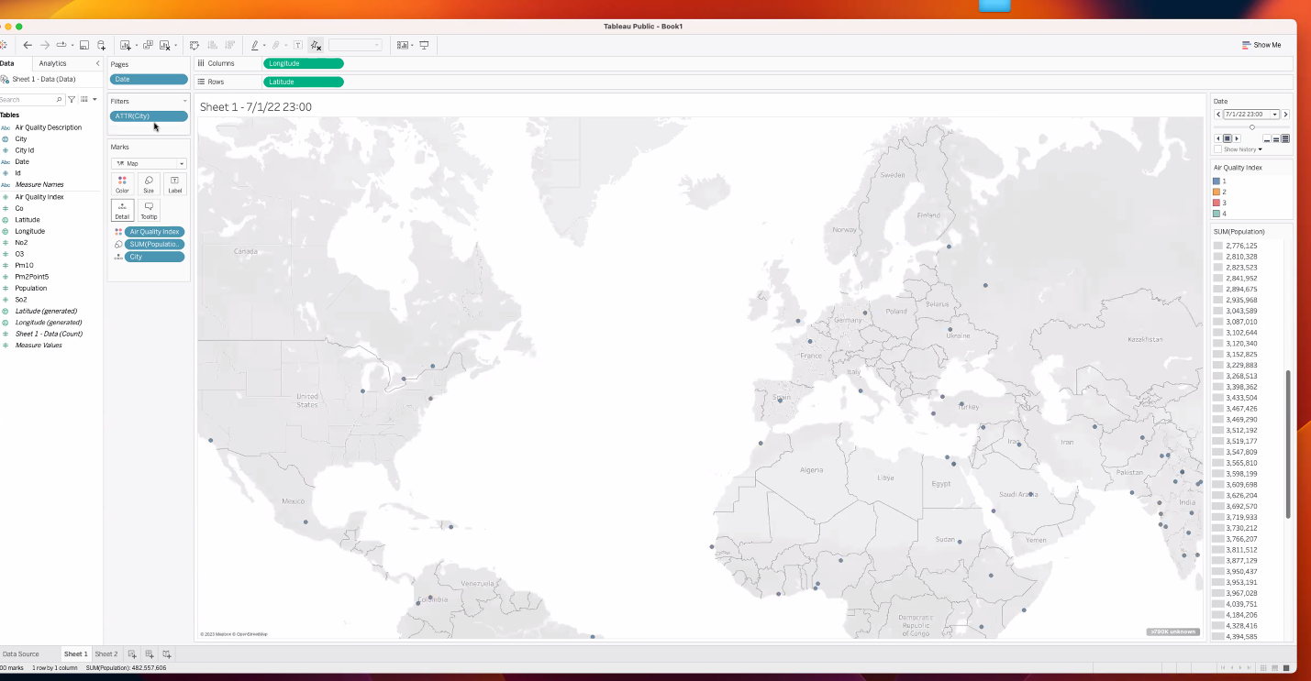
Visualize Data
Overview Map of Cities and Respective Air Quality

Slide 13
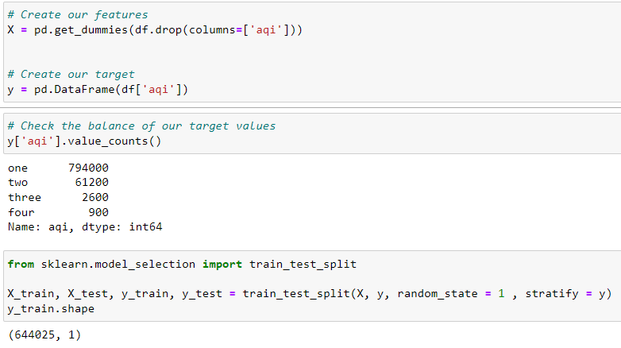
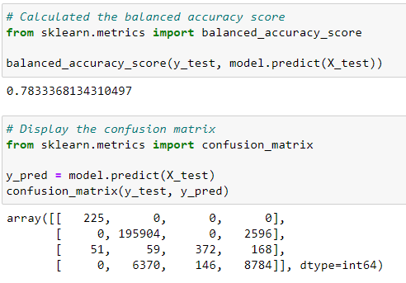
Machine Learning
Objective
We used a logistic regression model to predict the air pollution index level based on polluting gases such as Carbon monoxide (CO), Nitrogen monoxide (NO), Nitrogen dioxide (NO2), Ozone (O3), Sulphur dioxide (SO2), Ammonia (NH3), and particulates (PM2.5 and PM10).

Slide 14
Observations & Recommendations
Results
90% of the Air Quality is ranked as Level 1 – the lowest level of air quality standard
C-Group believes our current data has a 78% accuracy
We strongly recommend additional analysis to ensure the data utilized is appropriate for correctly
Recommendations for future analysis, C-Group would suggest the following:
Utilizing another weather index that has more accurate data for tracking the weather conditions.
Adding additional dimensions to our analysis.
Client “nice to have” feature to add to our toolset would be to include additional weather tracking data, (i.e., rainfall, wind index, average temperature, etc. for the Top 100 Cites

Slide 15
Observations & Recommendations (Project Hypothesis Explained)
C-Group Project Hypothesis
Hypothesis #1: Cities with larger populations have lower air quality
We could not definitely calculate that high-population cities have lower air quality with the limited about of datasets to examine.
Hypothesis #2: Verify that the Summer Season has the worst air quality, no matter where you are
We could not definitely verify that Summer Season has the worst air quality.
Unresolved Issues due to time restraints:
We could not use UNIX dates to predict air quality throughout the year
Due to the massive size of the input data file and the minute differences in Air Quality, displaying an interactive graphic would be impractical.

